Slide 1
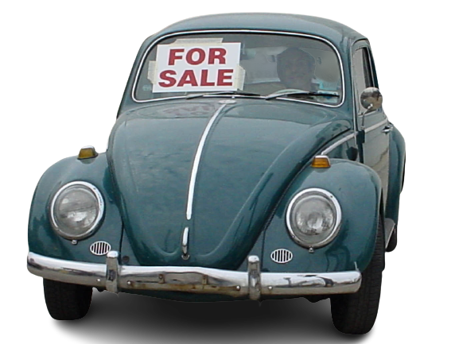

Used Car Price Prediction
CST2208 Data Science Topic Final Project
The focus of this project is developing machine learning models that can predict the price of a used car based on its features.
Yanhui Gao

Slide 2



Problem Statement
For this project, we are using the dataset on used car sales, available on Kaggle.
The features available in this dataset are Car’s Name, Year, Price, Mileage, Fuel, Seller Type, Transmission, and Owner.
Objective
Methodology
Goals
Practice the machine learning workflow We have learned so far to predict a car’s market price using its attributes.
The purpose of this project is to understand and evaluate used car prices.
The project was carried out in four key stages:
Study the Data.
Data cleaning.
Engineer the features.
Model building using various algorithms.
This project aims to deliver price prediction models to the public, to help guide the individuals looking to buy or sell cars and to give them a better insight into the automotive sector.

Slide 3

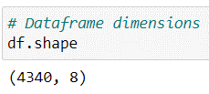
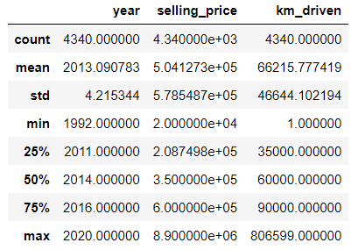
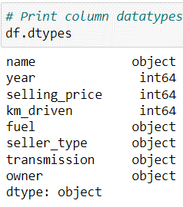

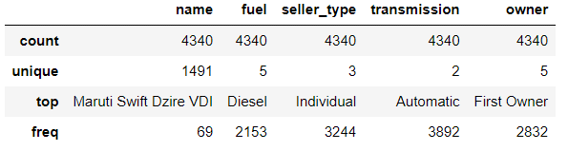
Study the Data
The data was scraped from Kaggle to get 4340 cars with each car having the following information.
Checked the data
Display the dataset basic information
Statistics for the numerical features
4340 observations and 8 features.
‘selling_price’ is technically the target.
No missing value.
No typos or inconsistent capitalization error.
All data types are correct.
Distributions of categorical features
Data Resource: https://www.kaggle.com/code/mdejazulhassan/vehicle-dataset-from-cardekho/data

Slide 4

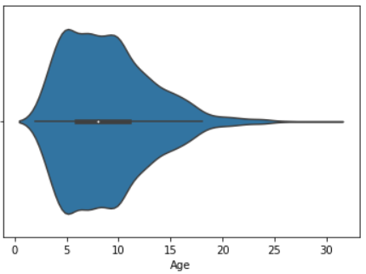

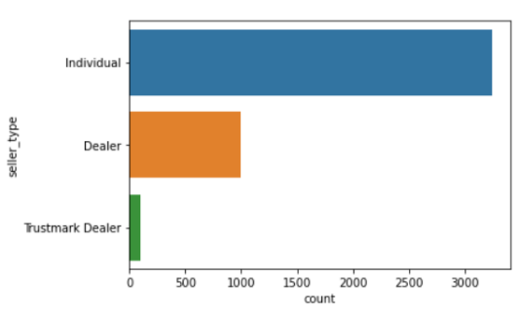
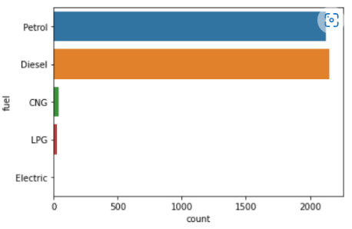
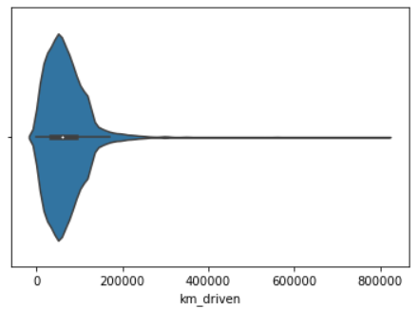
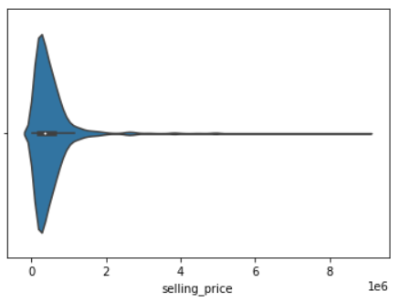
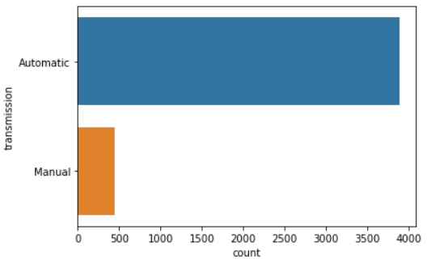
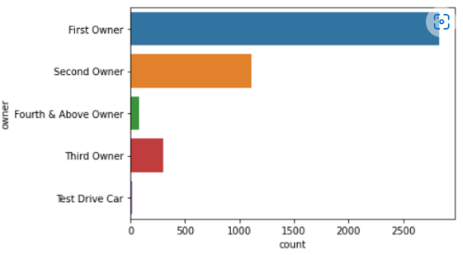
Data Cleaning
By carrying out Exploratory data analysis (EDA) on the cleaned data, various patterns were discovered in the dependent (selling_price) and independent variables.
Numerical: ‘Age’, ‘km_driven’, ‘selling_price’
Categorical: ‘fuel’
Categorical: ‘seller_type’
Cleaning
Distribution of the numerical variables.
Remove outliers with km_driven > 400,000
Categorical Variables
Categorical: ‘transmission’
Categorical: ‘owner’

Slide 5




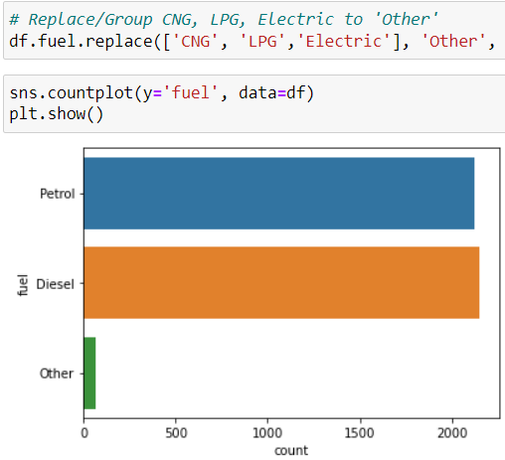
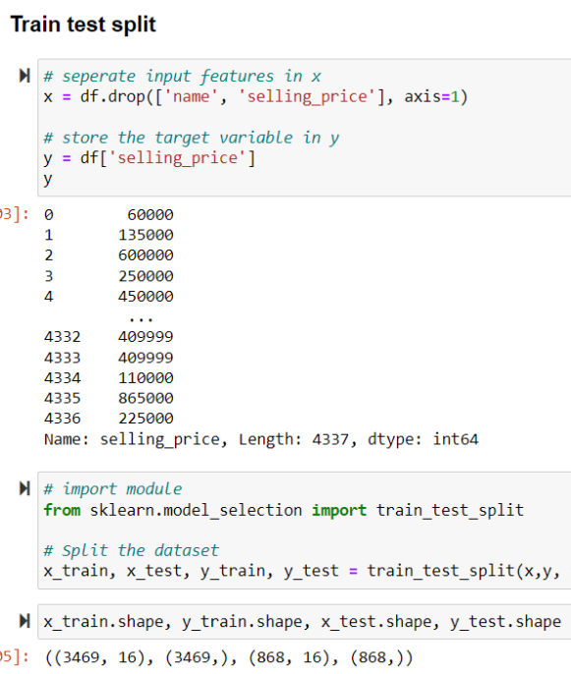
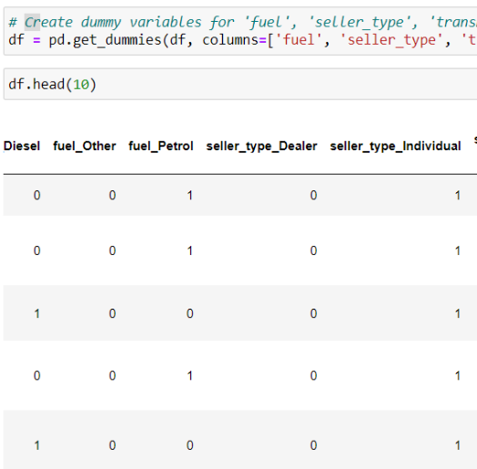
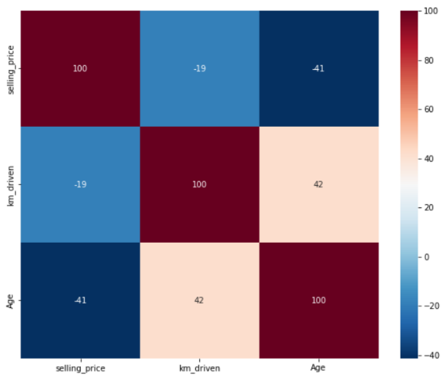
Feature Engineering
Before using the data we need to customize it. We will be performing all the below steps in Feature Engineering, with a 80-20 split on test and training data.
Group sparse classes
Splitting Training and Test data
Create dummy variables
Visualize the correlation

Slide 6


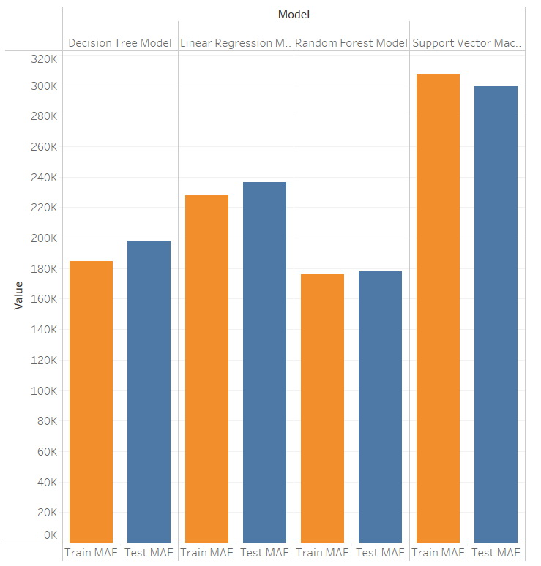
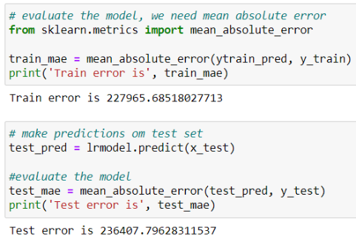
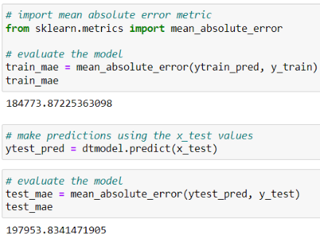



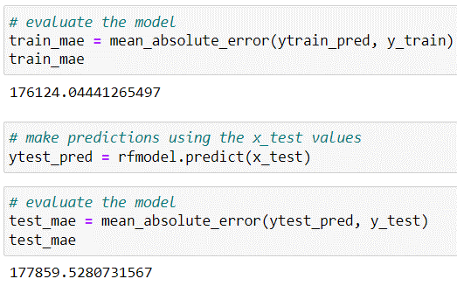
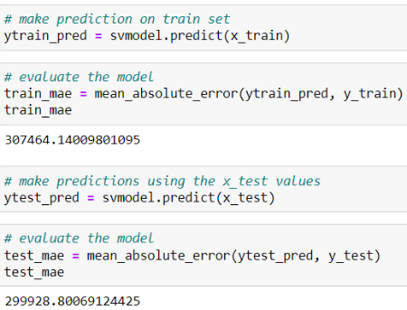
Model Training & Evaluation
Metric: Mean Absolute Error (MAE)
Represents the difference between the original and predicted values extracted by averaged the absolute difference over the data set.
Linear Regression
Model
Decision Tree Model
Random Forest Model
Support Vector Machines

Slide 7


Thank You
for your attention
Source code, data, PPT, Poster will be uploaded to GitHub:
https://github.com/YanhuiGao
Yanhui Gao

